Slide 1
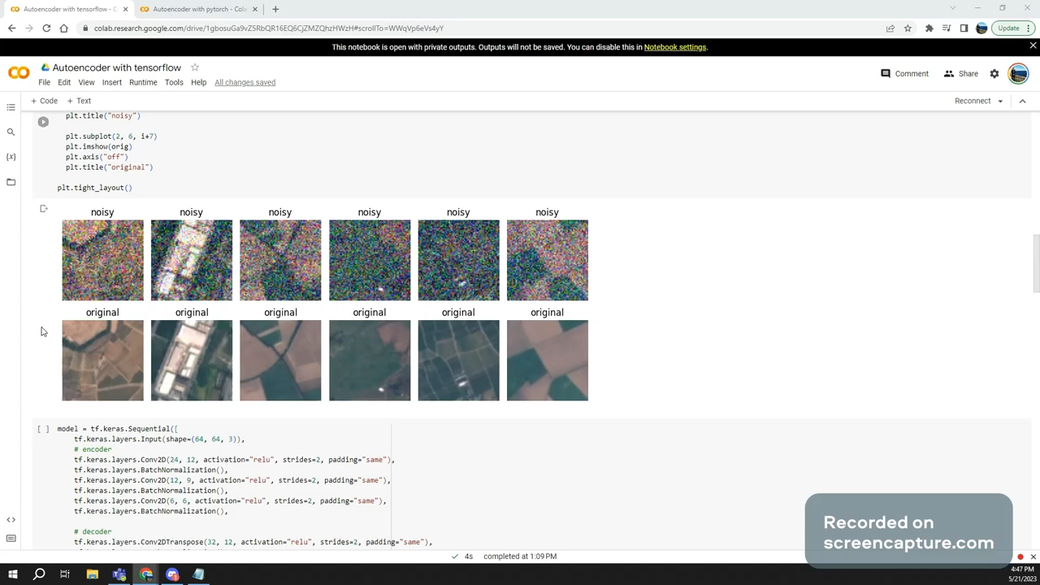
Working prototype

Slide 2

A Comparison of PyTorch and TensorFlow for Image Noise Reduction Using Autoencoders
Introduction:
Importance of reducing image noise for accurate image processing
Autoencoders as popular tools for image noise reduction
Aim of the research: Compare the effectiveness of PyTorch and TensorFlow in reducing image noise using autoencoder models
Goal: Determine the preferable framework for users based on their requirements

Slide 3
Literature Review
Autoencoders were first used for image denoising in 2006
Deep learning-based autoencoder methods outperform conventional methods
Dataset used: EuroSAT dataset consisting of 27,000 labeled satellite images
Gaussian noise added to images for denoising purposes

Slide 4
Autoencoder Model
Architecture: 3 convolutional layers followed by 3 transpose convolutional layers
Encoding step: Extract features from noisy image using multi-level residual network
Decoding step: Reconstruct image using deconvolutional neural network
Denoising step: Adaptive denoising module removes noise based on input image's noise level

Slide 5
Evaluation of Different Models
Comparison of methods using Peak Signal-to-Noise Ratio (PSNR)
Deep learning methods, including DnCNN, achieve higher PSNR scores
Performance varies based on the dataset and noise level

Slide 6
Research Methodology
Data loading: TensorFlow automatically handles data, PyTorch requires manual conversion
Data preprocessing: Gaussian noise added to dataset
Autoencoder model building: Same architecture implemented in both TensorFlow and PyTorch
Training and validation: Training for 100 epochs, comparison of training and validation losses

Slide 7
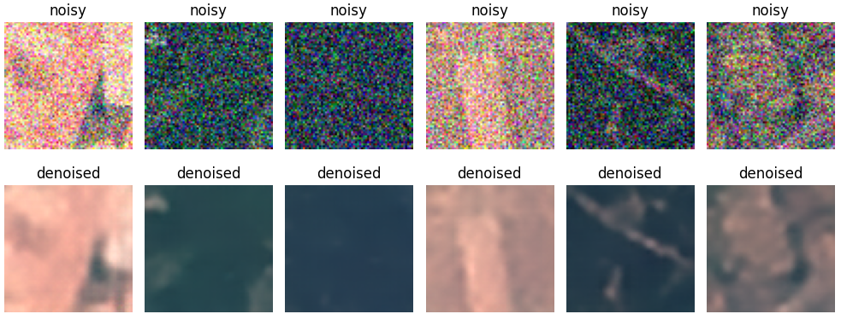
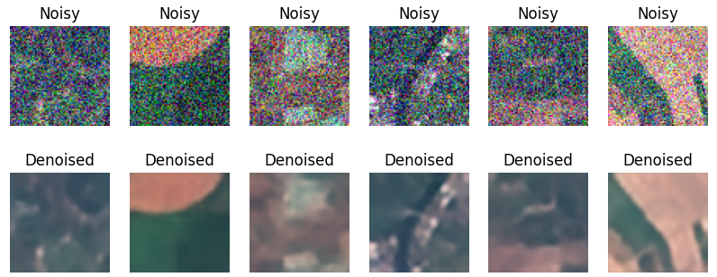
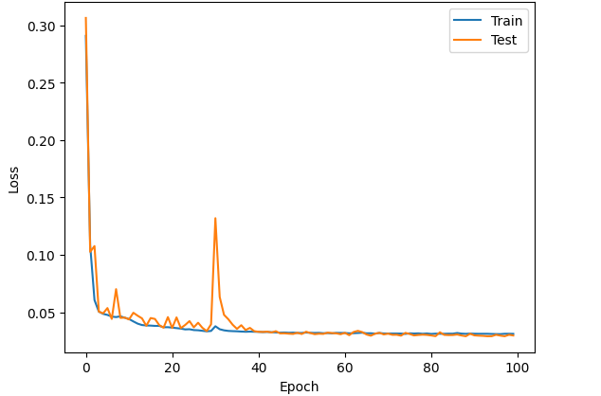
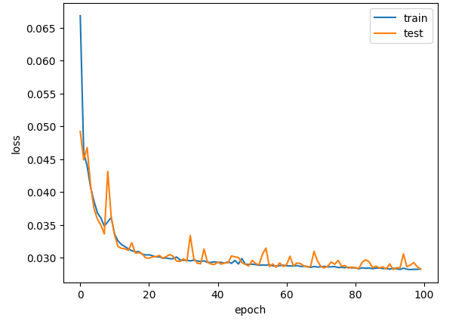
Tensorflow vs PyTorch

Slide 8
Findings and Conclusion
Both PyTorch and TensorFlow effective in reducing image noise
PyTorch shows slightly better performance and saves more RAM
TensorFlow exhibits clearer peaks in validation curve, PyTorch shows better overall training performance
Choice between frameworks depends on factors like ease of use, computational efficiency, and model flexibility
Recommendations for future improvements in autoencoder models

